Slide 1

NML Agenda
OGF 34, Oxford

Slide 2
OGF IPR Policies Apply
“I acknowledge that participation in this meeting is subject to the OGF Intellectual Property Policy.”
Intellectual Property Notices Note Well: All statements related to the activities of the OGF and addressed to the OGF are subject to all provisions of Appendix B of GFD-C.1, which grants to the OGF and its participants certain licenses and rights in such statements. Such statements include verbal statements in OGF meetings […]
Excerpt from Appendix B of GFD-C.1: ”Where the OGF knows of rights, or claimed rights, the OGF secretariat shall attempt to obtain from the claimant of such rights, a written assurance that upon approval by the GFSG of the relevant OGF document(s), any party will be able to obtain the right to implement, use and distribute the technology or works when implementing, using or distributing technology based upon the specific specification(s) under openly specified, reasonable, non-discriminatory terms. The working group or research group proposing the use of the technology with respect to which the proprietary rights are claimed may assist the OGF secretariat in this effort. The results of this procedure shall not affect advancement of document, except that the GFSG may defer approval where a delay may facilitate the obtaining of such assurances. The results will, however, be recorded by the OGF Secretariat, and made available. The GFSG may also direct that a summary of the results be included in any GFD published containing the specification.”
Notes:
IPR Notices Note Well for OGF meetings

Slide 3
OGF IPR Policies Apply
Some works (e.g., works of the U.S. government) are not subject to copyright. However, to the extent that the submission is or may be subject to copyright, the contributor, the organization he or she represents (if any), and the owners of any proprietary rights in the contribution grant an unlimited perpetual, non-exclusive, royalty-free, worldwide right and license to the Open Grid Forum under any copyrights in the contribution. This license includes the right to copy, publish, and distribute the contribution in any way and to prepare derivative works that are based on or incorporate all or part of the contribution, the license to such derivative works to be of the same scope as the license of the original contribution.
The contributor acknowledges that the Open Grid Forum has no duty to publish or otherwise use or disseminate any contribution.
The contributor grants permission to reference the name(s) and address(es) of the contributor(s) and of the organization(s) he or she represents (if any).
The contributor represents that contribution properly acknowledges major contributors.
The contributor, the organization (if any) he or she represents, and the owners of any proprietary rights in the contribution agree that no information in the contribution is confidential and that the Open Grid Forum and its affiliated organizations may freely disclose any information in the contribution.
The contributor represents that he or she has disclosed the existence of any proprietary or intellectual property rights in the contribution that are reasonably and personally known to the contributor. The contributor does not represent that he or she personally knows of all potentially pertinent proprietary and intellectual property rights owned or claimed by the organization he or she represents (if any) or by third parties.
The contributor represents that there are no limits to the contributor's ability to make the grants acknowledgments and agreements above that are reasonably and personally known to the contributor.
Notes:
IPR Notices Note Well for OGF meetings

Slide 4
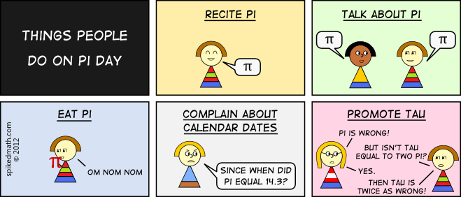
March 14 (^{2012.}3.141592653589793238462643383279502884 19716939937510582097494459230781640628620899862803482534211706798214 80865132823066470938446095505822317253594081284811174502841027019385211055596446
Source: http://spikedmath.com/490.html
Copyright SpikedMath, CC by-nc-sa license
Take notes

Slide 5
Agenda
Session 1: NML-NSI integration
NML Ports & Links
Subtopology
Port Identifier
Session 2: XML examples
Syntax
Subtopology
VLANs
Versioning (Lifetime & updates)
Session 3: Document editing

Slide 6
NML – NSI Integration

Slide 7
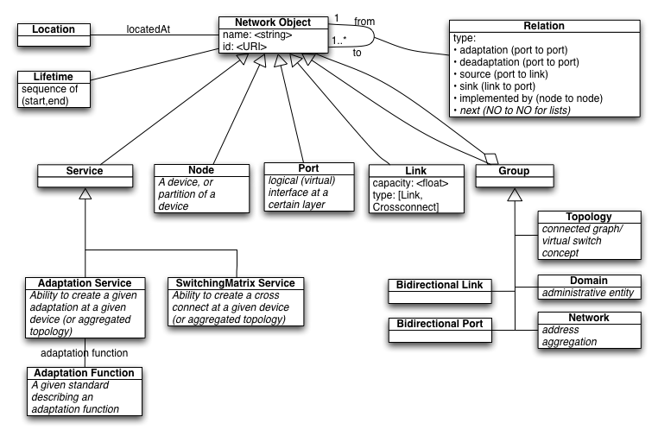
Current Schema (Sep 2011)
Missing from schema: Labels, Layer

Slide 8
Terminology
NSI | NML | NML Meaning
STP | Port | Unidirectional Logical Forwarding Port
SDP | ~Link | Unidirectional Logical Link Connection
Network | Topology | Subnetwork (collection of connected network elements)
NSA | ~Admin Domain | Control Plane autonomous system
 | Network | Local Area Network

Slide 9
DTOX vs. NML
DTOX | NML
Bidirectional | Unidirectional; grouping req'd for bidirection
connectedTo relations | Link objects Easier for path finding or to distinguish between link segment or end-to-end link

Slide 10
Bidirectional Compound Link
Switch A
Switch B
Switch C

Slide 11
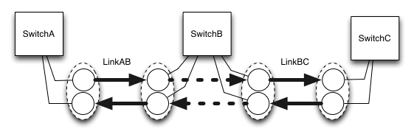
Bidirectional Compound Link
Node object
Link object
Relation
Port object
BidirectionalPort object

Slide 12
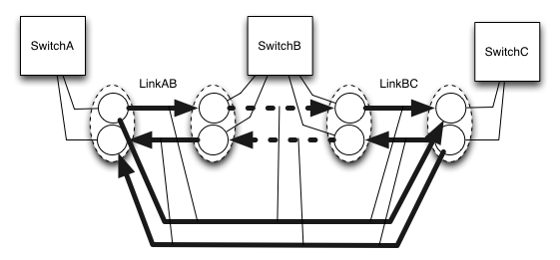
Bidirectional Compound Link

Slide 13
NML ...
... identifiers are opaque (not to be interpreted)
... describes a logical (not physical) topology
... can describe either aggregated or full topologies and anything in between
... can relate technology layers
... can describe VLANs
... can describe configurations and capabilities
... is versioned
... is work in progress

Slide 14
Hierarchical Topologies
Identifiers are not hierarchical
(separate addressing required for routing)
More flexible (add federation)
Three proposals to relate external ports to internal network
same identifier
alias
link
NorduNet
PSNC
NDNi
Pionier-o
NYC
NDNo
CPHo
CPH
Pionier-i
IONi
NYCi
POZo
CPHi
IONo
NYCo
POZi
Internet2-i
AMSi
AMSo
Internet2-o
NetherLight-o
Internet2
NDNo
NDNi
NetherLight-i
NetherLight
NDNi
NDNo
Slide courtesy Jerry Sobieski

Slide 15
URN & Type,Value
Current URN standard:
urn:ogf:network:example.net:2010:switch1
Proposal to introduce type,value to STPs
urn:ogf:network:example.net:2010:switch1?vlan=100&foo=bar
vlan=100 and foo=bar are separate type-values
urn:ogf:network:example.net:2010:switch1 is base ID.
Attributes (the query part) are never part of the assigned URN [draft-ietf-urnbis-rfc2141bis-urn-02]
Attributes can be defined easily in the topology, including ranges.

Slide 16
urn:ogf:network:nordu.net:2012:stp:ams80?vlan=
urn:ogf:network:example.net:2010:stp?localid=ams&vlan=1780
urn:ogf:network:example.net:2010:switch1:ge-0-0?vlan=80&foo=bar

Slide 17
XML Examples
(Note: unfinished slides, for discussion)

Slide 18
Decisions
Goal:
Make sure examples and choices are clear
Identify controversial choices
Consensus on non-controversial choices
schema - case
schema - relation
schema - service
subtopology - hasNode
subtopology - hasTopology
subtopology - inbound-outbound-ports
subtopology - alias
versioning - lifetime/alias
vlans - compoundlink
vlans - vlan
vlan - switchingservice

Slide 19
Schema
Case – Case of URLs in XML and RDF
CamelCase / lowerCamelCase
lowercase
Titlecase
Relation – word or URL to specify a relation in XML and RDF
word for XML; URL for RDF
URL for XML; URL for RDF
Service
<service type="adataptationservice">
<adaptationservice>

Slide 20
Subtopology
hasNode – how to relate a topology and a node
no relation (implicit)
hasNode relation per Node
hasNode relation with multiple Nodes
hasNodes relation with multiple Nodes
hasTopology – how to relate a topology and a subtopology
word for XML; URL for RDF
URL for XML; URL for RDF
inbound-outbound-ports
hasPort - unidirectional
hasBidirectionalPort – no inbound/outbound
hasInboundPort / hasOutboundPort
hasBidirectionalPort – inbound/outbound
alias
...
...

Slide 21
Subtopology
hasNode – how to relate a topology and a node
no relation (implicit)
hasNode relation per Node
hasNode relation with multiple Nodes
hasNodes relation with multiple Nodes
hasTopology – how to relate a topology and a subtopology
word for XML; URL for RDF
URL for XML; URL for RDF
inbound-outbound-ports
...
...
alias
...
...

Slide 22
Versioning
Controversial, let's discuss on the mailing list.

Slide 23
VLANs
compound link
...
...
VLAN link
...
...
switchingservice
see OGF 33

